Slide 1
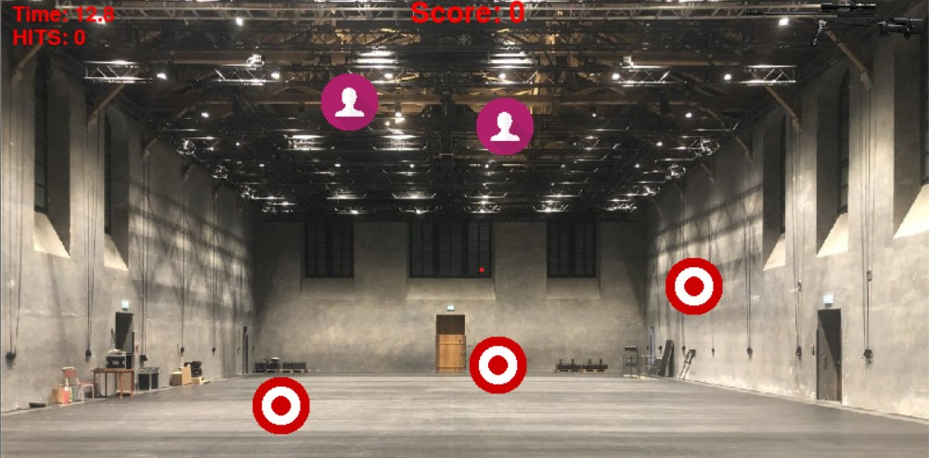
Shooting Range with Haply
Group 08 - Edoardo Panichi, Gioele Buriani, Giovanni Corvi, Severin Woernle

Slide 2
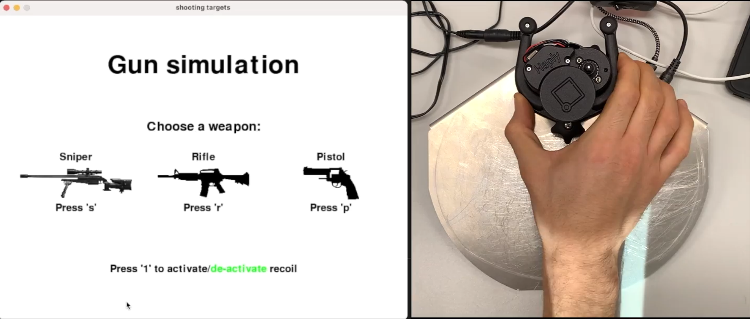

Slide 3
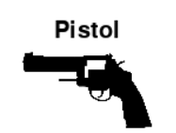
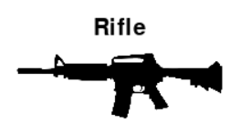
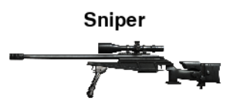
What is the experiment?
Scope: Hit the targets as many times as possible without hitting the civilians
What is the experiment?
Modalities:
- wind disturbance (sinusoidal)
- wind disturbance (sinusoidal)
+ haptic guidance (low)
- weapon weight (low)
- viscosity (low)
- wind disturbance (sinusoidal)
+ haptic guidance (high)
- weapon weight (high)
- viscosity (high)
- recoil (possible)
Notes:
1) The scope of the experiment is hitting the target as many times as possible without hitting the civilians
2) There are three modalities (see points) + extra experiment with recoil:
- wind disturbance is sinusoidal force coming from a randomized position
- haptic guidance is implemented with bump and hole method, higher guidance means larger gaussian and stronger force
- weapon weight is a constant downwards force
- viscosity is proportional to weapon moving speed
- recoil is an impulsive upwards force

Slide 4

Research Question
Will the haptic guidance make the weapons more precise despite the increase in weight and viscosity?
Will higher weight and viscosity reduce the number of kills/bullets per minute (KPM/BPM)?
Notes:
Extra question: does the recoil help? (makes you be more aware of when you shoot, but is an extra disturbance)

Slide 5

Methods
The idea is to gather data in the most objective and informative way possible:
Numerical Metrics
Online Survey
11 participants
Notes:
1. The experiments have been conducted randomizing the order of the task for the user. This has been done to achieve a greater objectivity in during the data collection phase. Each participant has done 4 different modality. The last one with sniper + recoil has been used only for the subjective feedback in the questionare
2. The online survey is used to collect the subjective feedback of the user.
3. A pool of at least 10 participant is suggest to generate some statistics.

Slide 6
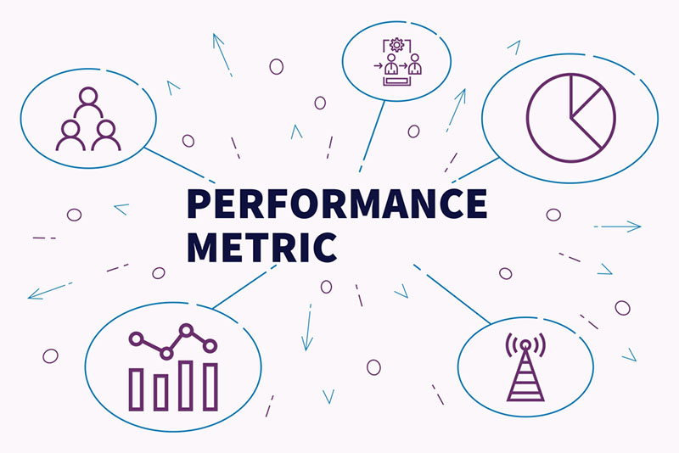
Metrics
We decided to consider three principal metrics:
Bullet per minute
Kill per minute
Mean Absolute Error (MAE)
Notes:
To find an answer to our research questions we decided to analyze mainly three metrics.
The Bullet per minute and kill per minute we expected to be indicative for to understand is higher movement constraints, so in the sniper and in the rifle, leads to a lower BPM and KPM.
With the SME we tried to understand if the height map, and so the haptic feedback, is a good tool to increase the precision of the user.

Slide 7
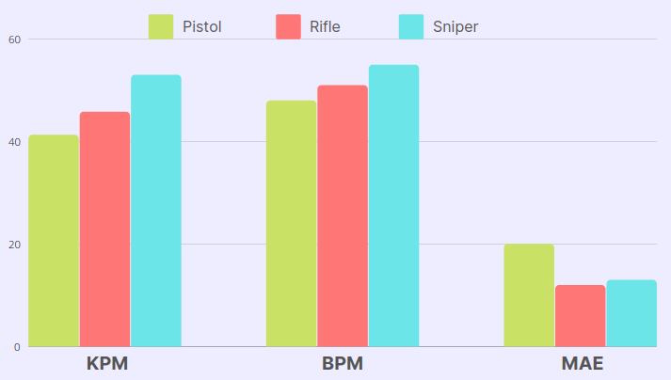
Metrics - Results
The haptic guidance proved to be effective
It increased KPM by 12-30% while decreasing the MAE by 50%
Differences in weight and viscosity between the weapons did not directly affect the performances (KPM,BPM)
Notes:
With recoil smallest sme but low KPM and BPM

Slide 8

Online Survey
For the subjective feedbacks we focused on three main point:
Importance of the Recoil
Gravity and viscosity
Aim Assist
Notes:
We believe that also the sensation of the users are important and therefore we realize an online questionnaire. We use it to gather some subjective feedbacks. In particular we used the last experiment, the one with the recoil, to understand if such a feedback can create a more immersive simulation.
The second question is the dedicated to understand if the viscosity and the gravity have worked properly, deluding the participant the current weapon was heavier, hence more difficult to be moved.
The last question focused on the aim assist, as we wanted to understand if the SME values where reflected by the perceive sensation of the user.

Slide 9
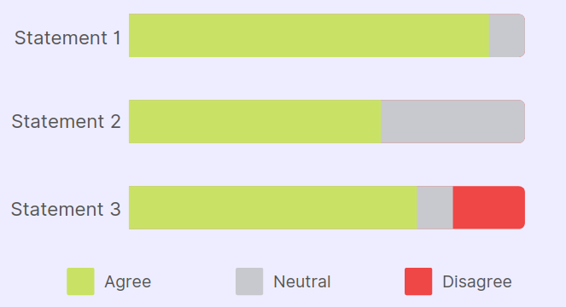
Online Survey - Results
Statement 1: The aim assist (haptic guidance) is effective
Statement 2: There is a notable difference between the three weapons
Statement 3: With the recoil the simulation feels more immersive
Notes:
Statement1: 90%-10%
Statement2: 65%-35%
Statement3: 70%-10%-20%

Slide 10
Discussion of results
Research questions:
Will the haptic guidance make the weapons more precise despite the increase in weight and viscosity?
Will higher weight and viscosity reduce the number of kills/bullets per minute (KPM/BPM)?
Haptic guidance improves accuracy and makes aiming faster
Higher weight and velocity does not reduce kills/bullets per minute (KPM/BPM)
Notes:
- The metric has shown that with increased haptic guidance the mean absolute error (MAE) decreases (, as well the number of missed targets.) That means the accuracy increases. Also the survey reveals that the haptic guidance helps aiming.
- We can therefore approve our first research question, which says that the haptic guidance will make the weapons more precise despite the increased weight and viscosity.
- Different from what could be expected from our second research question, we did not observe that increased weight and viscosity reduces the number of kills/bullets per minute (KPM/BPM).
- There are several reasons that can be causing this:
- Some of our participants claimed that they did not feel any notable difference between the weapons. This indicates that the weight and velocity were to low to disturb/ to slow down the movements of the participant. He/ She could still move the weapon (almost) as fast as without a weight and velocity .
- Another reason is that the participant maybe moved faster the lightweight weapon itself but spent more time aiming for the target.

Slide 11

Recommendations
Conduct more experiments
Increase the weight and viscosity for weapons with haptic guidance
Experiments with different target sizes
Notes:
- To improve the validity of our results more experiments should be conducted. 11 participants are too few to give reliable conclusions.
- The second recommendation is to increase the weight and viscosity of the weapons with haptic guidance. Thereby, the influence of the weight and viscosity might be visible in the results.
- Last, our experiment does not consider the distance to the target, which is one of the most if not the most important factor for choosing the right weapon. To find out which weapon is suitable for which distances, further experiments could be conducted with targets of different sizes.
Source of picture: https://resources.bibblio.org/the-future-of-content-discovery, 24.03.2022

